Slide 1
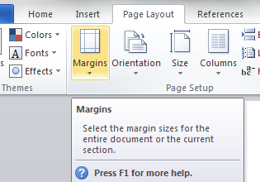
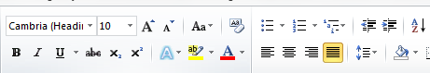

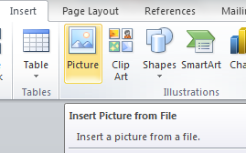
Chapter 17: Document Production (Word)
Task 3: Tawara Star Family Cars
Using a suitable software package (Word), load the file Text.RTF Page Layout Set the following Margins/Page Size – Margins – Top, Bottom, Right and Left – 2CM Set the page size to A4 Set the page orientation to Portrait. Header – Name - (Left) File Name – (Centre) Form– (Right) Footer – Todays Date (Left) Page Number – (Centre)
Text Formatting Insert this title at the start of the document Tawara Star Family Cars (apply Title style). On a new line below the title add the text - Latest Company News by: and add your name (apply Subtitle style). Apply the Body Text style to remaining text and format into two columns (1 centimeter gap between the columns) Identify the subheadings and apply the Subheading Style. Insert the text file NEWMODS.RTF before the subheading Sales Report. Format the text to match the style of the main document.
House Style Specification Sheet Title: Arial, Red, 36 pts, centre aligned Subtitle: Times New Roman, Black, Italic, 14 pts, Underlined, Right aligned Subheading: Arial, Black, 12 pts, Centre Aligned and one clear line space after a subheading. Body Text: Serif, Black, single line spacing, 12 pts and Justified. One clear line space after each paragraph.

Slide 2
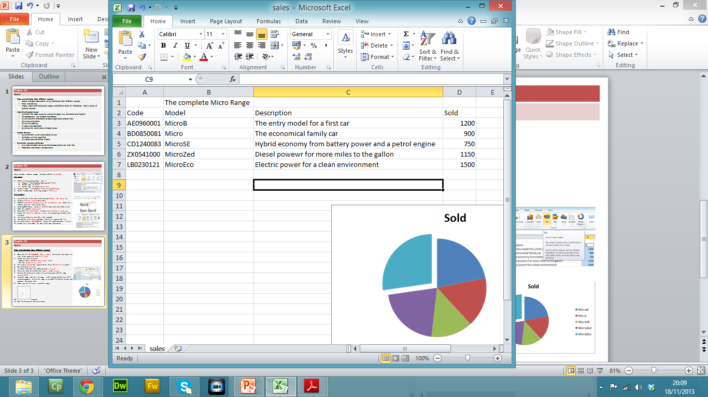
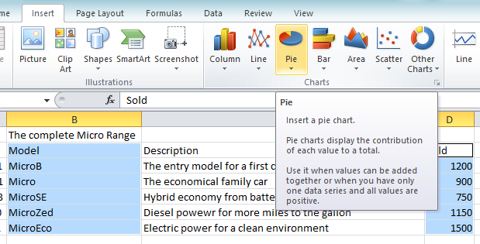
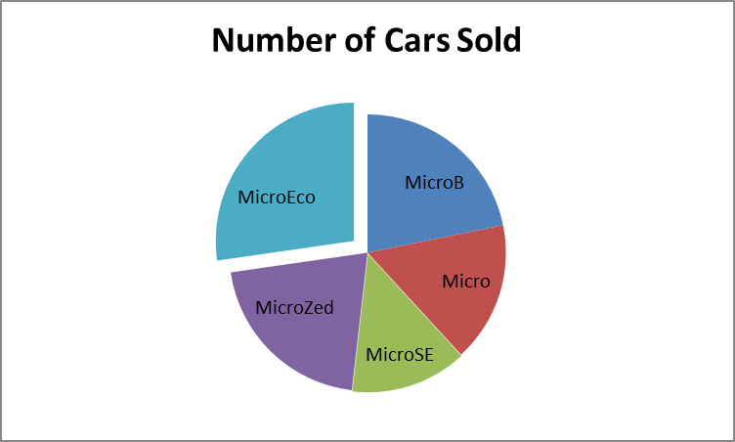
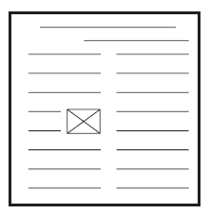
Chapter 17: Document Production (Word)
Task 3: Tawara Star Family Cars
Enter and edit data from different sources Open the file SALES.CSV (Open in Excel) and use the sales figures for each of the models to create a pie chart. Format the chart to display: Segment labels with the model names in full The title: Number of cars sold Pull out or highlight the segment which shows the best selling model. Do not display a legend. Insert the chart after the subheading Sales Report. Resize the chart to fit within the margins of the column. Replace the text (Insert picture of new showroom) with the image showroom.JPG Align the image with the right margin of the column and the top of the second paragraph. Re-size the image so its width fills half the column and maintain the aspect ratio. Make sure the text wraps round the image. Spell-check the document. Save the document with a new name.

